Slide 1
AIR QUALITY FORECAST
BY
Student Name(s): Sandhiya K
Priyanka C
Janani B
Indumathi R
Department: BCA,
College : AAA(W), Walajapet.
Date : 27-03-2025

Slide 2
ABSTRACT
Air pollution poses serious threats to both the environment and human health, originating from sources like industrial emissions, vehicle exhaust, and biomass burning. Major pollutants such as PM2.5, PM10, O₃, CO, SO₂, NO₂, and CO₂ contribute to respiratory diseases, cardiovascular issues, and climate change. Artificial Intelligence (AI) and Machine Learning (ML) techniques have advanced air pollution forecasting and early-warning systems. Hybrid AI models offer better accuracy than single models, improving pollutant prediction and disease forecasting. Performance metrics like R², RMSE, MAE, and MAPE help evaluate model efficiency. AI-based systems also assist in predicting climate changes and extreme weather events, aiding policymakers in mitigation efforts.

Slide 3
INTRODUCTION
Air pollution, driven by industrialization, urbanization, and human activities, poses serious threats to health and the environment. It contributes to millions of deaths annually and accelerates climate change through fossil fuel combustion and deforestation.
Background:
Streamlit is a open source python library that simplifies building interactivity web applications for data science and machine learning. It allows users to create apps with minimal code, offering build in support for visualizations, user input handling, and real-time updates.

Slide 4
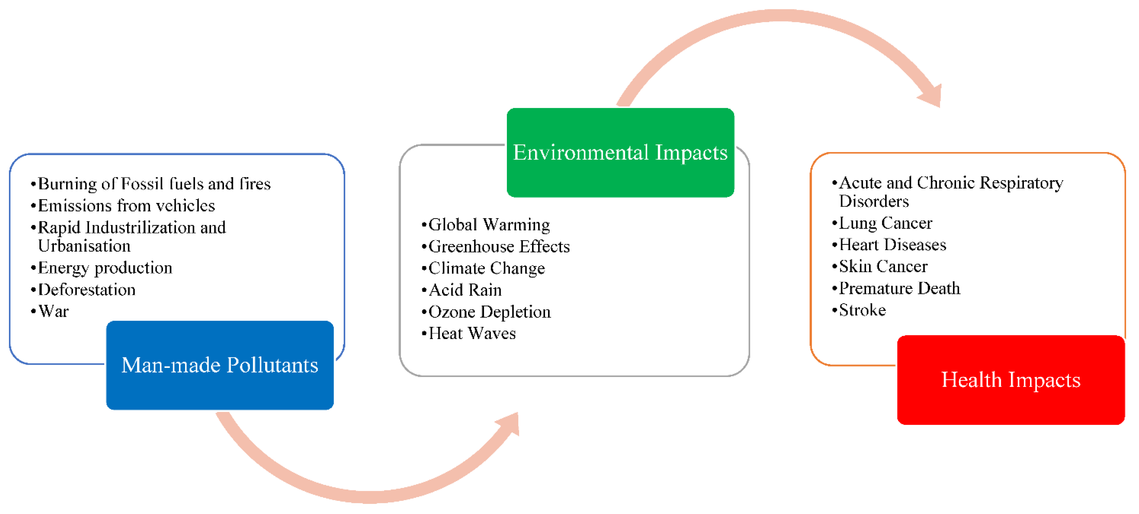
Figure: Environmental Impacts

Slide 5
METHODOLOGY
Data collection and Preprocessing:
Data Collection involves acquiring information from sources like public data sets, APIs, Sensors, and web scrapping. Data Preprocessing ensures data quality by handling missing values, removing duplicate, and transforming data for analysis. It also includes normalization, feature Engineering, and splitting data into training and testing sets to enhance model accuracy.
Model Selection:
Model selection involves choosing the best algorithm based on dataset characteristics and performance metrics. Techniques like cross-validation and hyperparameter tuning help optimize models for accuracy and efficiency.

Slide 6
Implementation and Results
Hardware and software requirements:
Here are the requirements for doing the projects three tools and software’s are necessary to develop the software:
HARDWARE REQUIREMENTS:
System : Pentium IV 2.4GHz
Hard Disk : 512 GB
Mouse : Logitech
Keyboard : 110 keys enhanced
Ram : 4GB
SOFTWARE REQUIREMENTS:
O/S : Windows 10
Language : PYTHON
IDE : Visual Studio Code

Slide 7
DISCUSSION
Limitations:
Machine learning models face limitations such as data quality issues, high computational costs, and difficulty in interpretability.
Sudden environmental changes and overfiatting can also reduce forecasting accuracy and reliability.
Future Work:
Future work should focus on improving AI models by integrating real-time data and advanced deep learning techniques.
Enhancing interpretability and using IoT-based monitoring can further improve prediction accuracy and applicability.

Slide 8
SOLUTION IMPACT
Sustainability Impact:
AI-based air pollution forecasting helps reduce health risks and environmental damage by enabling early warnings and preventive measures.
Integrating AI with IoT enhances real-time monitoring, leading to better decision-making for cleaner air.
Real-world Applications:
Smart Cities: AI-powered air monitoring to enforce environmental regulations.
Healthcare: Predict pollution-related health risks in high-risk areas.
Industry: Optimize factory emissions and improve compliance with green policies.

Slide 9
CONCLUSION
Air pollution remains a significant global challenge, impacting both human health and the environment. The integration of AI and machine learning in air quality forecasting has improved predictive accuracy, enabling better early-warning systems and policy decisions.
By leveraging green skills and advanced AI techniques, this project enhances air quality monitoring and helps individuals and organizations take preventive measures. Interactive tools like Streamlit further allow real-time visualization and decision-making.
The results demonstrate that AI-driven models can effectively identify pollution trends, highlighting the best and worst months for air quality. Visualization techniques, such as bar charts, provide valuable insights for researchers, governments, and environmental agencies.
Future research should focus on improving model accuracy, integrating real-time sensor data, and expanding applications to smart city infrastructures. Advancements in AI and IoT can further revolutionize air quality management, leading to healthier urban environments.

Slide 10
REFERENCES
Mr. K.NaveenKumar, MCA., Developer IoT enabled environmental toxicology for air pollution monitoring using AI techniques. Environ. Res. 2025, 205, 112574.
Mrs. Vijayalakshmi, Edunet Foundation., IoT enabled environmental toxicology for air pollution monitoring using AI techniques. Environ. Res. 2025, 205.
Mr. NARESH, Edunet Foundation., IoT enabled environmental toxicology for air pollution monitoring using AI techniques. Environ. Res. 2025, 205, 11234.

Slide 11
THANK YOU…

